Slide 1
Homework 2
50.042
Foundations of Cyber security

Slide 2
Substitution Cipher (Recap)
Monoalphabetic
Alphabet: ABCDEFGHIJKLMNOPQRSTUVWXYZ
Key: PDKIFMRBHSONCGXUTJWEYLQAZV
Polyalphabetic
Can be substituted by different letters of the alphabet in different cases
Developed ~800 AD (Al-Kindi)
Vigenere cipher, Enigma machines are more modern examples

Slide 3
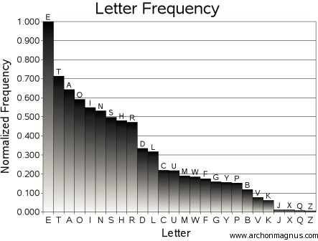
Substitution Cipher
Trivial to break with letter frequency

Slide 4
WORD FREQUENCY
Short words provide useful clues. One-letter words are either a or I.
The most common two-letter words are to, of, in, it, is, as, at, be, we, he, so, on, an, or, do, if, up, by, and my.
The most common three-letter words are the, and, are,for, not, but, had, has, was, all, any, one, man, out, you, his, her, and can.
The most common four-letter words are that, with, have, this, will, your, from, they, want, been, good, much, some, and very.

Slide 5
Substitution Cipher
Convert the ciphertext obtained from the server into its plain text by using the substitution method
Replace the characters of the ciphertext with characters of the letter
frequency + special characters like “ ”, “,”, “?”, “!” etc.

Slide 6
One-Time Pad (OTP)
Currently the plaintext associated with the given cipher text is
“Student ID 1000000 gets 0 points”
Manipulate the cipher text such that the plaintext associated with it contains the 1000000 replaced with your own school ID and the score 0 replaced with the maximum score you wish to get for this lab (4) ;)
Eg. “Student ID 100xxxx gets 4 points”
Remember
Ptxt (xor) OTP = Ctxt : Encryption
Ctxt (xor) OTP = Ptxt : Decryption
…
You know the plaintext and you will receive the ciphertext from the
challenge server. You’ll have to perform a ‘known-plaintext’ attack

Slide 7
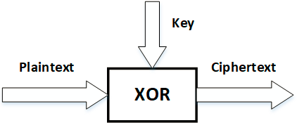
One-Time Pad (OTP)
Key is random, is long as plaintext (at least), and is used only once
This scheme cannot be broken
No matter how strong an adversary is, the person cannot learn anything about plaintext

